Slide 1

DEPARTMENT OF COMPUTER SCIENCE AND ENGINEERING
MARRI LAXMAN REDDY
INSTITUTE OF TECHNOLOGY AND MANAGEMENT
(AUTONOMOUS)
(Affiliated to JNTU-H, Approved by AICTE New Delhi and Accredited by NBA & NAAC With ‘A’ Grade)
REAL-TIME BASED FACIAL RECOGNITION SYSTEM USING TWILIO
Under the Guidance
of
Mrs. G. Anitha
Assistant Professor
Presented By:
G ARUN KUMAR REDDY -177Y1A0568
D SEKHAR -177Y1A05A6

Slide 2
OUTLINE
ABSTRACT
MOTIVATION
SCOPE
PROPOSED SYSTEM
SYSTEM REQUIREMENTS
METHODOLOGY
TEST CASES
REFERENCES

Slide 3
ABSTRACT
Criminals are widely using Social Media & Social Networks to
Commit the Crime and they are being part of cyber space as well, in this regard.
A facial recognition system is a technology capable of dentifying
or verifying a person from a digital image or a video frame from a
video source. There are multiple methods in which facial recognition systems work, but in general, they work by comparing
selected facial features from given image with faces within a database.

Slide 4
MOTIVATION
Face recognition is one of the widely used technologies or systems in which it has the potential to perform tasks such as to have records provided in by the dataset in many areas such as the school and colleges attendance systems, it can also be helpful in catching the thieves or the terrorist, can be helpful in the security of common people and the much needed security areas in the country. Face recognition can be used by the government to verify the voters list, find missing persons, find the population or census, immigration process, also provide security over internet scams protecting Ecommerce and highly used in the medicine and healthcare range

Slide 5
SCOPE
Face filtering biometric technology is amazingly adaptable and this is reflected in its wide scope of potential applications.
Face biometrics can possibly be incorporated anyplace you can locate a cutting edge camera.
Law implementation offices the world over use biometric programming to filter faces in CCTV film, just as to recognize people of enthusiasm for the field.
It can also be helpful in catching the thieves or the terrorist.

Slide 6
PROPOSED SYSTEM
When image quality is taken into consideration, there is a plethora of factors that influence the system’s accuracy.
Most face recognition algorithms are extremely sensitive to lighting conditions, so that if it was trained to recognize a person when they are in a dark room, it probably won’t recognize them in a bright room, etc.
This is why it is so important to use a good image pre-processing filters before You'll need to tell the classifier where to find the data file you want it to use.
The one I'll be using is called haarcascade_frontalface_default.xml.

Slide 7
SYSTEM REQUIREMENTS
HARDWARE REQUIREMENTS:
Processor : i3 Or More.
Hard Disk : Minimum 50 Gb.
Display : Lcd/Led Colour.
Accessories : Web Cam, Keyboard & Mouse.
Ram : Minimum 2 Gb.
SOFTWARE REQUIREMENTS:
Python
Opencv-4.2.0
Numpy-1.18
Haarcascade_frontalface_default.xml

Slide 8
METHODOLOGY
OpenCV has a number of significant abilities as well as utilities which appears from the outset. The OpenCV helps in recognizing the frontal face of the person and also creates XML documents for several areas such as the parts of the body.
Python has proven to give best results in the face recognition and detection systems. Together face recognition and detection becomes very easy and fruitful with the help of the python programming language and OpenCV

Slide 9

OUTPUT
It will notify detected persons location.
We can integrate with the cctv camera systems which may help in search of criminals.

Slide 10
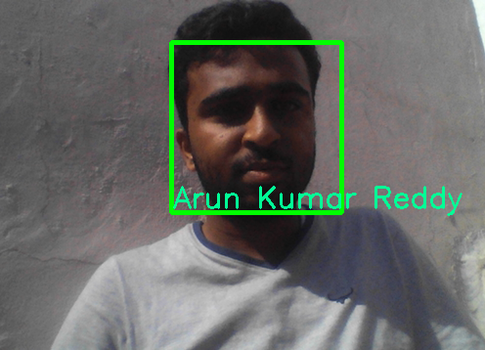
TEST CASE-1

Slide 11
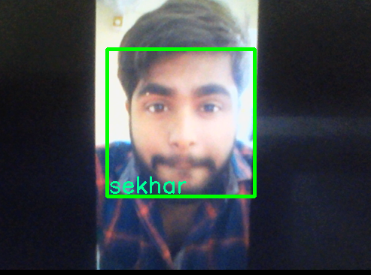
TEST CASE-2

Slide 12
REFERENCES
Udacity: building face classifier
Github: Codes for Haarcascade
Codingblocks.com: applying knn to find face match

Slide 13


